Slide 1

Assalamu Alaikum
Enhancement of Lifetime of LEACH Network by Selecting Cluster Head Based on Residual Energy
Presented by
Ali Haider Doha C141088
Kazi Mushfikur Rahman C141090
Mohammad Rakibul Hasan C141063
Supervised by
Abdullahil Kafi
Assistant Professor, Dept. of C.S.E, IIUC

Slide 2
Abstract
Wireless sensor network is one of the most widely used thinks in today’s world. Though, this kind of network is much complex and its energy consumption is high.
In this paper we modified “LEACH“, the widely optimistic wireless sensor network's routing protocol.
Our upgraded “LEACH" protocol used improved cluster head selection technique with the concept of assisted node that’s more energy efficient and it’s more enhanced than previous “LEACH" protocol technique.

Slide 3
Contribution
Improvement of Cluster Head selection technique
Hibernate sensor node scheme
Minimum 5% better network lifetime than LEACH
Maximum 20% better network lifetime than LEACH

Slide 4
Organization
LEACH
Literature Review
Limitation and Objective
Methodology
Simulation
Mathematical Analysis
Performance Comparison
Conclusion and Future Work
Reference

Slide 5
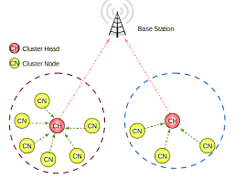
LEACH Routing Protocol
LEACH (Low-Energy Adaptive Clustering Hierarchy) protocol is a TDMA based MAC protocol. The main aim of this protocol is to improve the lifespan of wireless sensor networks by lowering the energy. Leach protocol consists of two phases[19]:
Set-up phase
Steady phase
Figure 01: LEACH routing protocol

Slide 6

LEACH Routing Protocol (Cont.)
Set-Up Phase
In the set-up phase, the main goal is to make cluster heads(CH) and cluster formation according to CH[3].
Set-up phase has three fundamental steps:
Cluster head advertisement
Cluster set up
Creation of transmission schedule
Figure 02: Setup Phase

Slide 7
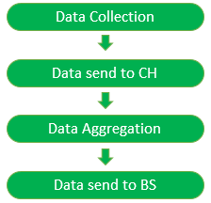
LEACH Routing Protocol (Cont.)
Steady Phase
Sensor nodes send their data to the cluster heads.
Cluster head aggregates all the collected data and forwards data to the base station.
Figure 03: Steady Phase

Slide 8
Literature Review
“LEACH" (Low-Energy Adaptive Clustering Hierarchy), which is
A clustering-based protocol
Randomized rotation of local clusters
Evenly distribute the power load among the sensors[1]
“LEACH" protocol is able to distribute energy dissipation evenly throughout the nodes or sensors, tends to doubling the useful system lifetime for the network the simulation[2].

Slide 9
Literature Review (Cont.)
An algorithm which will eliminate higher energy consumption but also it covers a wide range of area in a sensing manner[3].
The proposed protocol with two recent clustering approach, which is distributed approach and centralized approaches also showed their performance against different “LEACH" routing protocol[4].
Modified “LEACH" outperformed “LEACH” using metrics of cluster head formation, throughput and network life[4].

Slide 10
LEACH Limitations
Major Limitations of LEACH
Limited lifespan of network
Ignored the residual energy consideration for cluster head selection
No real energy balancing

Slide 11
Objectives
Provide energy efficient “LEACH" protocol
Improve Cluster Head selection technique
Enhance network lifetime
Reduce the dead nodes per round

Slide 12
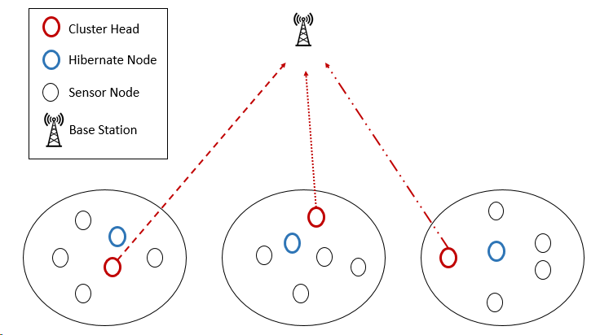
UP-LEACH Architecture
Figure 04: Architecture of UP-LEACH

Slide 13
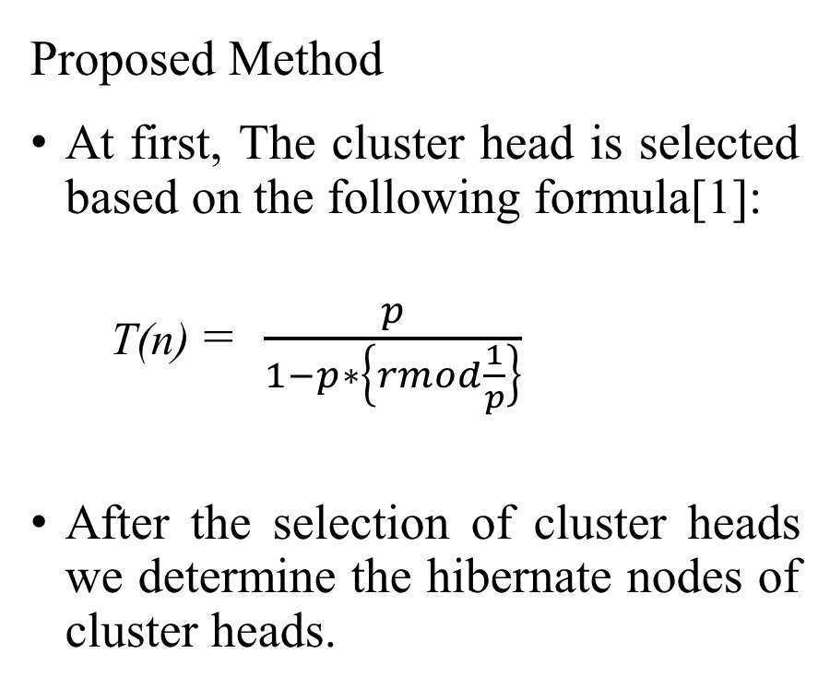
Methodology
Proposed Method​
At first, The cluster head is selected based on the following formula[1]:​
T(n) = $\frac{p}{1−p∗\left\{rmod\frac{1}{p}\right\}}$
After the selection of cluster heads we determine the hibernate nodes of cluster heads.
Round Processes
Limit–threshold – ((E*20)/100)
Nodes energy<Limit-threshold
No
Yes
Figure 05: Round Flow Chart

Slide 14
Methodology (Cont.)
When the energy of the cluster head is less than a limit value, the cluster head becomes a normal node.
At that time the hibernate node of that cluster head will come into play the role of Cluster Head.
Then again another hibernate node will be determined for the newly formed Cluster Head. Here we have ensured that the node which just played the role of Cluster Head will not be selected as Hibernate node immediately.
All the selected Cluster Heads and Hibernate nodes stored in an structure array.
Add ( S(i).id , C[] )​
Add ( S(p).id , H[] )​

Slide 15
Simulation Environment and Parameter
1. Omnet++
Omnet has a model for component architecture, which are programmed in C++. It has also a high-level language (NED). In here, we can modify codes and models for our research purpose.
2. Matlab
Matlab is very unique and more user friendly for using matrix and vector manipulation. It’s comes with basic set of tools for visualizing data and for performing calculation on matrices and vectors.

Slide 16
Network Parameters
Network Parameters | Value
Network Size Bit Per Message Initial Energy of Sensor Nodes Transceiver idle state energy consumption Data Aggregation/ Fusion Energy consumption Amplification Energy (Cluster to BS) d <= do Amplification Energy (Cluster to BS) d > do | 200 X 200 m2 4000 0.5 J 50 nJ/bit E_{DA} = 5 nJ/bit/signal E_{fs} = 10 pJ/bit/m² E_{amp} = 0.0013 pJ/bit/m⁴
Figure 06: Network parameter

Slide 17
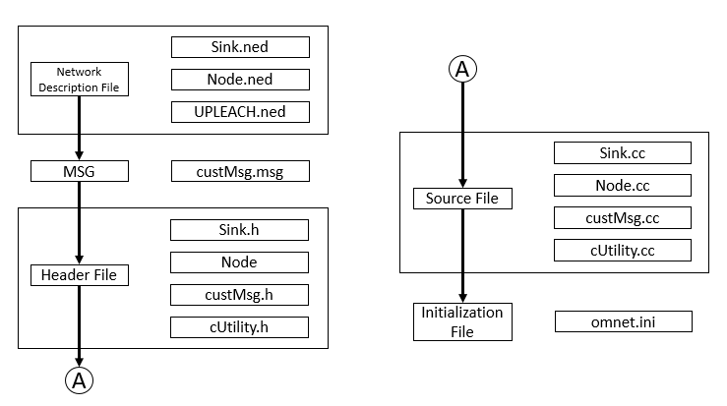

Simulation Phases
Figure 07: UPLEACH Simulation Phase

Slide 18
Simulation Data
First Iteration Cluster Head Matrix
xd | yd | distance | id
85.27281 | 89.30603 | 159.4223 | 12
234.9289 | 311.1384 | 116.4979 | 25
220.3239 | 368.359 | 169.5813 | 35
264.717 | 221.9252 | 68.3301 | 39
317.2354 | 302.1898 | 155.5214 | 49
272.9212 | 259.7236 | 94.25715 | 52
369.7098 | 39.90836 | 233.304 | 56
364.7339 | 369.4003 | 236.2916 | 58
361.7166 | 293.9417 | 187.0222 | 62
337.3407 | 361.9637 | 212.3552 | 63
397.3383 | 391.6698 | 275.0995 | 89
212.6977 | 397.4296 | 197.8375 | 92

Slide 19
Simulation Data (Cont.)
Figure 08: Dead node per round
Figure 09: Alive node per round
Figure 07 shows how many nodes died per round. After all nodes are dead, the above figure formed.
Figure 08 shows how many nodes alive per round. After all nodes are dead, the above figure formed.

Slide 20
Simulation Data (Cont.)
Figure 10: Residual Energy per round
Figure 11: Alive node per round
Figure 09 shows that residual energy per round consist in the simulation
Figure 10 shows that the energy consumption rate per round. This figure formed for energy consumption rate.

Slide 21
Energy Calculation ???

Slide 22
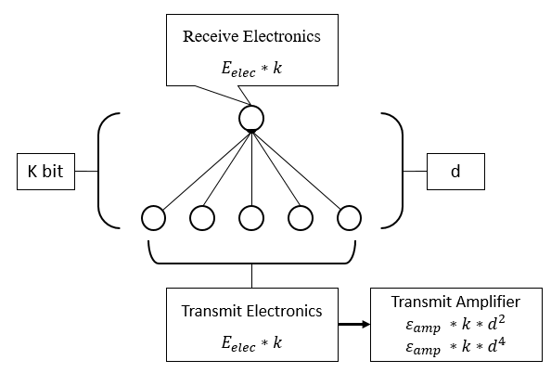
First Order Radio Model (FORM)

Slide 23
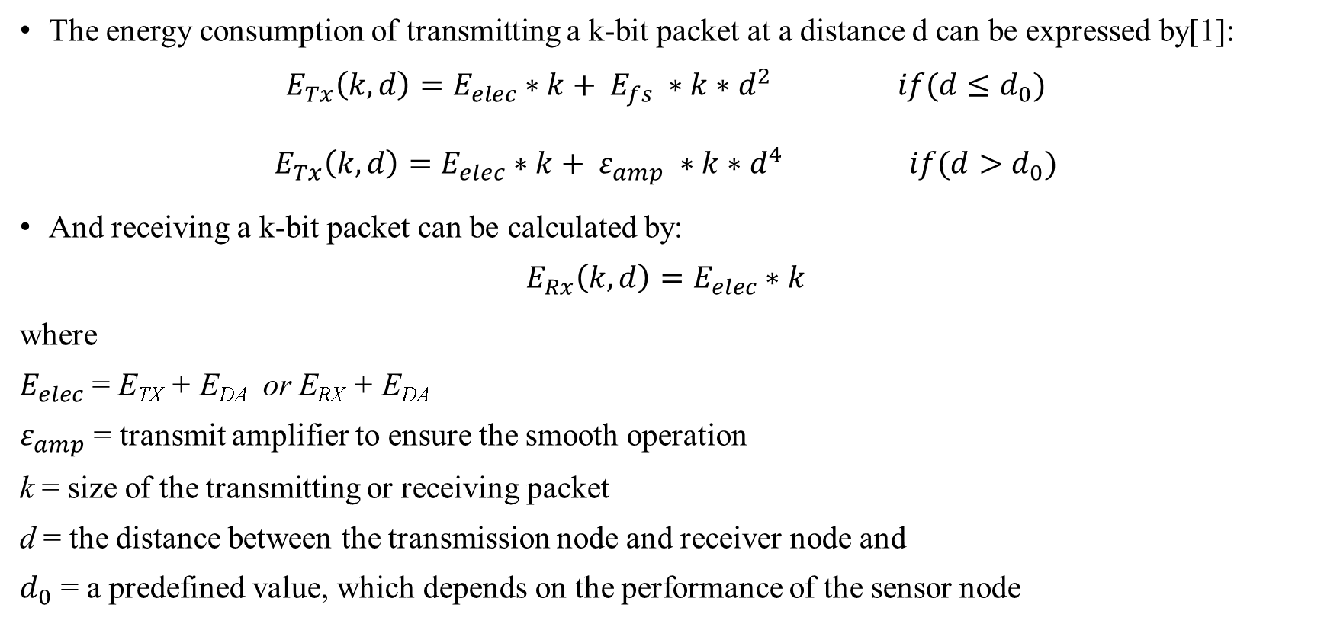
First Order Radio Model (Cont.)
The energy consumption of transmitting a k-bit packet at a distance d can be expressed by[1]:
$$E_{Tx}\left(k,d\right)=E_{elec}∗k+ E_{fs} ∗k∗d^{2} if(d≤d_{0})$$
$$E_{Tx}\left(k,d\right)=E_{elec}∗k+ ε_{amp} ∗k∗d^{4} if(d>d_{0})$$
And receiving a k-bit packet can be calculated by:
$$E_{Rx}\left(k,d\right)=E_{elec}∗k$$
where
$E_{elec}$ = E_{TX} + E_{DA} or E_{RX} + E_{DA}
$ε_{amp}$ = transmit amplifier to ensure the smooth operation
k = size of the transmitting or receiving packet
d = the distance between the transmission node and receiver node and
$d_{0}$ = a predefined value, which depends on the performance of the sensor node

Slide 24
Individual Round Energy Consumption
Transceiver idle state energy consumption
Same energy cost for these following steps:
When CH receives data, energy consumption is same as receiving energy which is stated below.
CH forming | Sent data to sink(BS)
CH remains as CH
H → CH conversion
Here energy consumption is same as transmitting energy which is stated below.

Slide 25
Mathematical Analysis
In idle state:
per round energy consumption = 0.000000005J
1000 round energy consumption = 1000 * 0.000000005 = 0.000005J
Suppose, Message size = 4000bit.
d0 = 50m
d1= 20m
d2= 60m
Required energy to receive:
receiving energy = ( E_{RX} + E_{DA} ) * 4000
= {( 0.000000005 + 0.000000005) * 4000 }
= 0.00004J

Slide 26
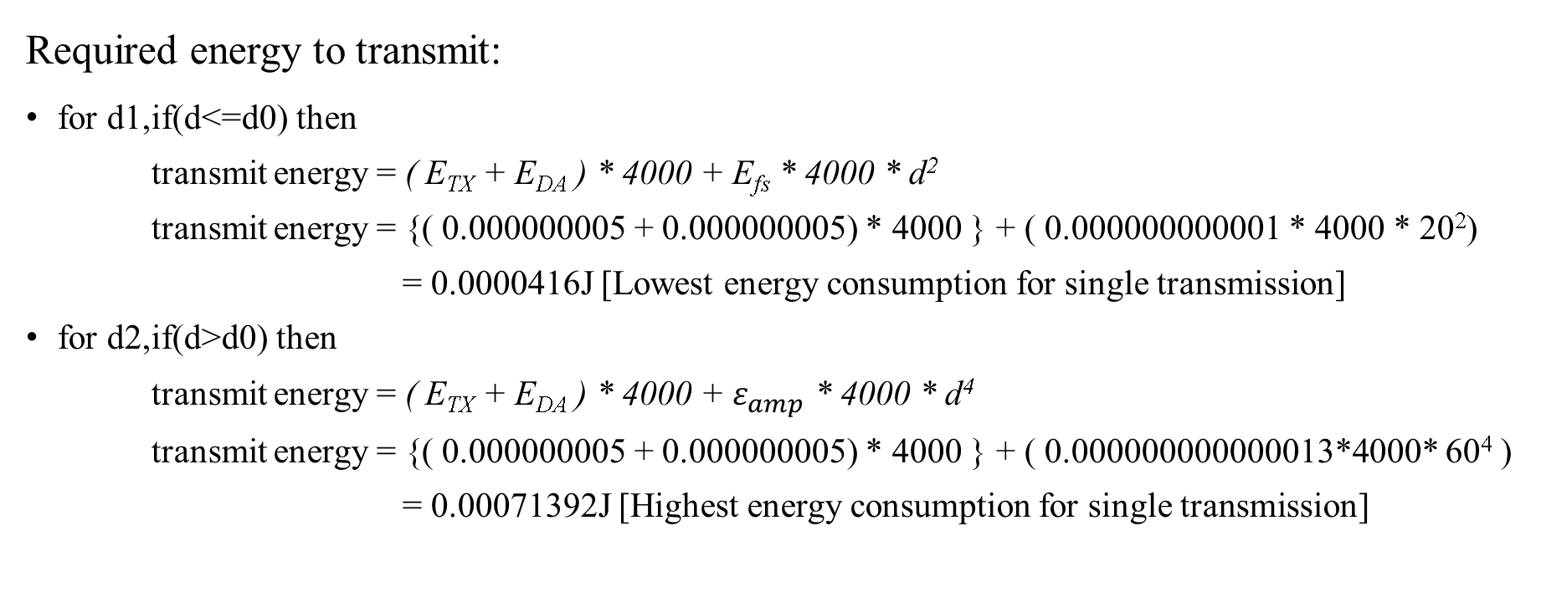
Mathematical Analysis (Cont.)
Required energy to transmit:
for d1, if(d<=d0) then
transmit energy = ( E_{TX} + E_{DA} ) * 4000 + E_{fs} * 4000 * d²
transmit energy = {( 0.000000005 + 0.000000005) * 4000 } + ( 0.000000000001 * 4000 * 20²)
= 0.0000416J [Lowest energy consumption for single transmission]
for d2, if(d>d0) then
transmit energy = ( E_{TX} + E_{DA} ) * 4000 + $ε_{amp}$ * 4000 * d⁴
transmit energy = {( 0.000000005 + 0.000000005) * 4000 } + ( 0.000000000000013*4000* 60⁴ )
= 0.00071392J [Highest energy consumption for single transmission]

Slide 27
Mathematical Analysis (Cont.)
Hibernate node’s energy remain same till they turned into CH.
Suppose, a CH remains as CH for 10 round. For this 10 rounds, linked hibernate node have no energy dissipation. So its energy remains same for 10 round i.e. till convert to CH.
H.E = 0.0000416 (Lowest energy dissipation per round)
10 round will cost = 10 * 0.0000416 = 0.000416 J
H.E = 0.00071392 (Highest energy dissipation per round)
10 round will cost = 10 * 0.00071392 = 0.0071392 J

Slide 28
Mathematical Analysis (Cont.)
If total round is 1000, then Hibernate node’s energy remains same for 100times.
So, for 1000 round,
H.E = 0.000416 * 100 = 0.0416 (Lowest energy dissipation)
H.E = 0.0071392 * 100 = 0.71392 (Highest energy dissipation)
This energy is saved in 1000 rounds for single CH.
If there are 10 CH, then
Total lowest energy dissipation = 0.0416 * 10 = 0.416 J [0.83% of total network energy]
Total highest energy dissipation = 0.71392 * 10 = 7.1392 J [14% of total network energy]
By this energy, the network can run another 100+ rounds.
But in simulation around 8%-10% energy saved that enhance the network lifetime.

Slide 29
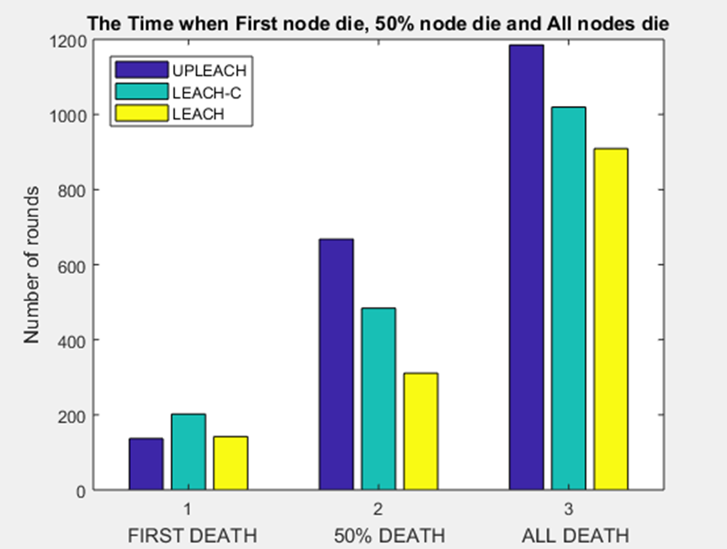
Performance Comparison
This figure differentiates occurrence of dead node placed in round for three LEACH variations.
Figure 12: Dead Node Count Per Round

Slide 30
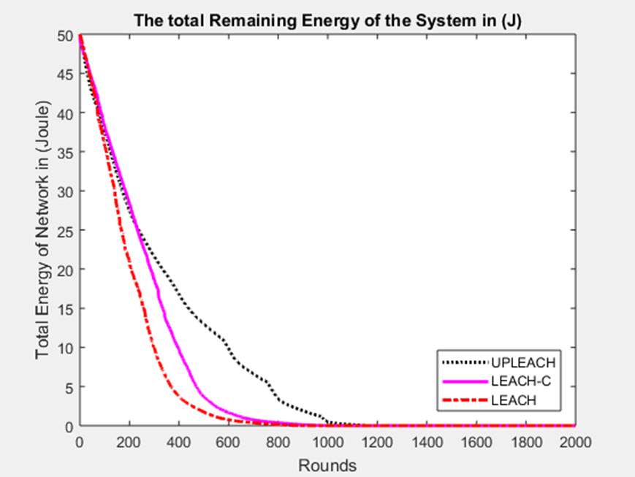
Performance Comparison (Cont.)
This figure shows the flow of residual energy placed in round for three LEACH variations.
Figure 13: Total remaining energy of the system per round

Slide 31
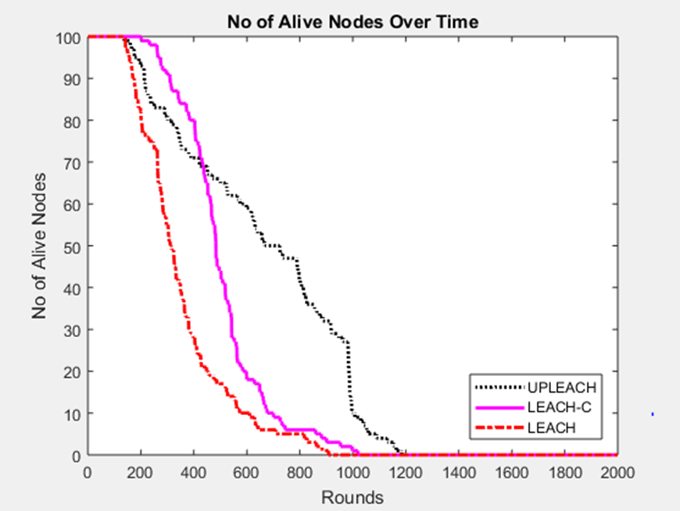
Performance Comparison (Cont.)
This figure shows alive nodes ending into dead nodes placed in rounds for three LEACH variations.
Figure 14: Number of alive nodes per round

Slide 32
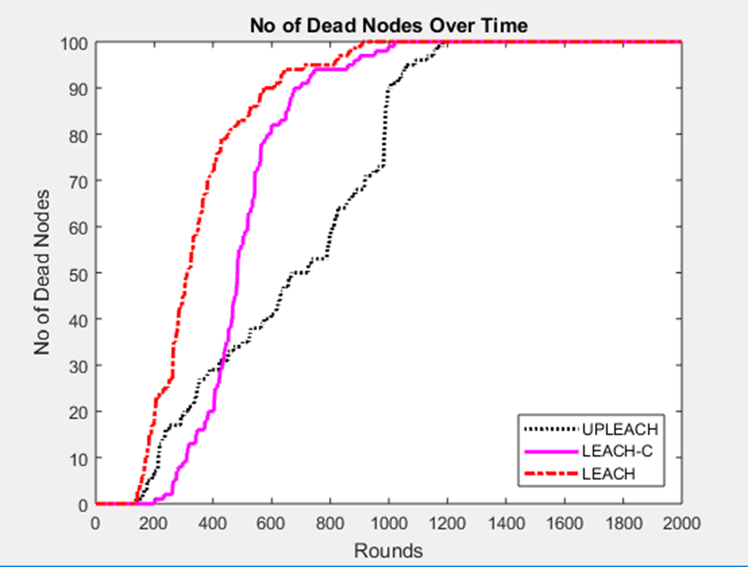
Performance Comparison (Cont.)
This figure shows dead nodes increment in respected rounds for three LEACH variations.
Figure 15: Number of dead nodes per round

Slide 33
Conclusion
We work on LEACH by implement different cluster head formation technique.
By upgrading the leach protocol, we found the efficiency in the result.
In here our “LEACH” protocol performs higher in terms of energy efficiency and nodes survival ratio.
Future Work
We will try to develop an efficient wireless node charging module to enhance the life time of sensor node.
Moreover, we will develop an energy station which recharges the energy nodes that lead to an immortal WSN.
Multihop and Intra-Cluster communication development.

Slide 34
Reference
[1] | W. Heinzelman, A. Chandrakasan, and H. Balakrishnan.“Energy-Efficient Communication Protocols for Wireless Microsensor Networks”. In Proceedings of Hawaiian International Conference on Systems Science, January 2000.
[2] | Amit Karmaker; Md. Mahedee Hasan; y,Shafika Showkat Moni and Mohammad Shah Alam.“An Efficient Cluster Head Selection Strategy for Provisioning Fairness in Wireless Sensor Networks” IEEE International WIE Conference on Electrical and Computer Engineering (WIECON-ECE), December 2016, AISSMS, Pune, India
[3] | D. Mahmood, N. Javaid1, S. Mahmood, S. Qureshi, A. M. Memon, T. Zaman , “MODLEACH: A Variant of LEACH for WSNs”, Eighth International Conference on Broadband and Wireless Computing, Communication and Applications
[4] | Fareed, M.S.; Javaid, N.; Ahmed, S.; Rehman, S.; Qasim, U.; Khan, Z.A., “Analyzing Energy-Efficiency and Route-Selection of Multi-level Hierarchal Routing Protocols in WSNs”, Broadband, Wireless Computing, Communication and Applications (BWCCA), 2012 Seventh International Conference on , vol., no., pp.626,631, 12-14 Nov. 2012.
[5] | V. Mhatre and C. Rosenberg, “Design Guidelines for Wireless Sensor Networks: Communication, Clustering and Aggregation”, Ad Hoc Networks, 2(1), 2004, pp.45-63.
[6] | M. M. Zanjireh, A. Shahrabi, and H. Larijani, ”ANCH: A New Clustering Algorithm for Wireless Sensor Networks,” In 27th International Conference on Advanced Information Networking and Applications Workshops (WAINA), pp. 450-455, 2013.
[7] | A. Patra and S. Chouhan, ”Energy efficient hybrid multihop clustering algorithm in wireless sensor networks,” In International Conference on Communication, Networks and Satellite, pp. 59-63 Dec. 2013.

Slide 35
Reference
[8] | W. B. Heinzelman, A. P. Chandrakasan, and H. Balakrishnan, ”AnApplication-Specific Protocol Architecture for Wireless Microsensor- Networks,” IEEE Transactions on Wireless Communications,vol.1, no. 4, pp. 660-670, 2002.
[9] | C. Y. Chong and S. P. Kumar, “Sensor Networks: Evolution, Opportunities and Challenges”, Proceedings of the IEEE, 91, No. 8, pp. 1247-1256, Aug 2003.
[10] | M. Younis, P. Munshi, G. Gupta and S. M. Elsharkawy, “On Efficient Clustering of Wireless Sensor Networks”, Second IEEE Workshop on Dependability and Security in Sensor Networks and Systems, 2006, pp. 78-91.
[11] | S. V. K. a. A. Pal, "Assisted-Leach (A-Leach) Energy Efficient Routing Protocol for Wireless Sensor Networks," International Journal of Computer and Communication Engineering, vol. Vol. 2, 4, July 2013.
[12] | M. S. A. A. K. SHAW, "Transmission Time and Throughput analysis of EEE LEACH, LEACH and Direct Transmission Protocol: A Simulation Based Approach," Advanced Computing: An International Journal ( ACIJ ), vol. Vol.3, p. 5, September 2012.
[13] | B. N. N. A. W. A. K. Salim EL KHEDIRIa, "A New Approach for Clustering in Wireless Sensors Networks Based on LEACH," International Workshop on Wireless Networks and Energy Saving Techniques (WNTEST), 2014.
[14] | M. A. G. Leena Y.Barai, "Performance Evaluation of LEACH Protocol for Wireless Sensor Network," International Journal of Innovative Research in Advanced Engineering (IJIRAE), vol. vol 1, no. 6, 2014.
[15] | X. Y. Xiaowen Maa, "Improvement on LEACH Protocol of Wireless Sensor Network," Trans Tech Publications, Switzerland, Vols. 47-350, 2013.

Slide 36
Reference
[16] | G. Horvat, D. Zagar and D. Vinko, "Influence of node deployment parameters on QoS in large-scale WSN," in 3rd Mediterranean Conference on Embedded Computing (MECO), Montenegro , 2014.
[17] | Amit Parmar, and Ankit Thakkar, “An improved modified LEACH-C algorithm for energy efficient routing in Wireless Sensor Networks”, Nirma University Journal of Engineering and Technology, VOL. 4, N0. 2, JUL-DEC 2015.

